Slide 1
Cross-Cultural and Cross-Linguistic Ontologies Ontology i18n/L10n
By Yuri Tijerino
Kwansei Gakuin University

Slide 2
Funny Engrish

Slide 3
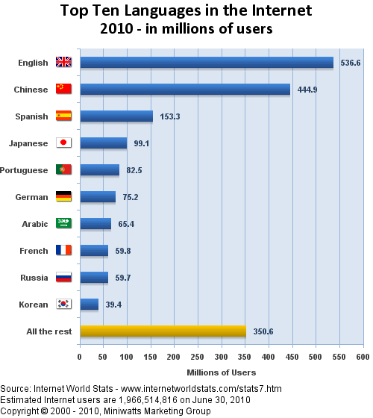
Motivation
As of June 2010, 72.6% of the almost 2 billion Web users, the ultimate audience for the Semantic web, speak a language other than English

Slide 4
Some definitions

Slide 5
GLOBALIZATION: DEFINED*
Globalization
The process of making all the necessary technical, financial, managerial, personnel, marketing and other enterprise decisions necessary to facilitate localization.
Internationalization (i18n)
The process of ensuring at a technical/design level that a product can be easily localized.
Localization (L10n)
The process of modifying products or services to account for differences in distinct markets.
Translation
The process of converting verbal communication from one language to another.
Locale
The part of the user’s environment that is dependent on language, country/region and cultural conventions.
*SOURCE: The Localization Industry Primer. ©2003 LISA.

Slide 6
What is Software Internationalization in?
Internationalization:
Designing applications to easily support different languages and regions.
Abbreviated as “i18n”.
(There are 18 letters between ‘i’ and ‘n’).
Localization:
Adapting software to a specific region.
Abbreviated as “L10n”.

Slide 7
Ontology localization defined
The adaptation of an ontology to a particular language and culture Suárez-Figueroa & Gómez-Pérez
The process of adapting a given ontology to the needs of a certain community, which can be characterized by a common language, a common culture or a certain geo-political environment Cimiano et al.

Slide 8
More specifically
Ontology localization is a transformation process that takes an ontology as input and produces an (adapted) ontology as output, whereby the output can be the same ontology, extended with labels in additional languages, or a new ontology Cimiano et al.

Slide 9
Formal definition of i18n Ontology
An i18n ontology is an ontology O_{i18n}, such that
O_{i18n} = O_{orig} - λ_{loc}
where O_{i18n} represents the starting ontology, which might be written in any given language,
while λ_{loc} consists of all variant characteristics externalized from the original ontology

Slide 10
Formal definition of L10n Ontology
An L10n ontology is an ontology O_{L10n}, such that
O_{L10n} = O_{i18n} + λ_{loc}
_{or}
O_{loc} = O_{i18n} + λ_{loc}
e.g.
O_{en-US} = O_{i18n} + λ_{en-US}
where O_{L10n,} O_{loc and} O_{en-US} represents the localized, for a particular language
while λ_{loc} consists of all variant characteristics externalized from the original ontology for a particular locale, en-US in the case λ_{en-US}

Slide 11
What can we learn from software i18n/L10n?

Slide 12
Abbreviated Common Software Engineering i18n/L10n practices
Lexical externalization
No text visible to user is embedded in text
Grammatical externalization
Avoid use of language constructs for interaction
UI externalization
Formatting, styling, color schemes, graphics, etc
Functional externalization
Dates, numbers, sorting, etc.

Slide 13
Are ontologies culture/language- dependent?

Slide 14
Why i18n/L10n matters in Ontology
According to Guarino[1], ontologies are language dependent, while conceptualizations are language independent.
Why?
Conceptualizations refer to abstract, simplified views of the world
An ontology requires formal specication of the underlying conceptualization [2]

Slide 15
Why do we “really” care?
Multi-lingual support:
Inclusively support multilingual queries by design
Cross-lingual support:
Reuse conceptualized components for other languages and/or cultures
Portability:
Ontologies that are shareable and reusable across languages and cultures

Slide 16
How do we ontology i18n/L10n practically?

Slide 17
Intensional vs Extensional Definitions
Intensional definitions capture the intended meaning of concept and relations necessary and suficient to define a domain
Become language-dependent when formalized
Extensional definitions rely on listing all possible things that are realizations of the conceptualization or its components
Inherently culture-independent

Slide 18
Example of an extensional definition
"nation of the world" might be given by listing all of the nations of the world, or by giving some other means of recognizing the members of the corresponding class.
An explicit listing of the extension, which is only possible for finite sets and only practical for relatively small sets, is called an enumerative definition. Wikipedia

Slide 19
Example of an intensional definition
"bachelor" is "unmarried man."
Being an unmarried man is an essential property of something referred to as a bachelor.
It is a necessary condition: one cannot be a bachelor without being an unmarried man.
It is also a sufficient condition: any unmarried man is a bachelor Wikipedia

Slide 20
So what is better? -- A recipe ontology example --
Use more intensional definitions?
Conceptualization:
Recipe (English and Japanese)
Ingredients, Amounts, Units
Preparation steps (instructions)
Breaks down at language and cultural levels
Units not same, homonyms (cup not same), no turkeys in Japan
Use more extensional definitions?
Simpler to use extensional definitions for ingredient substitutions

Slide 21
Some Recommendations for Ontology i18n/L10n

Slide 22
Externalize language definitions the software enginering way
Learn from software engineering
Software eng. Ontology eng. (locale, string) ➔ (locale, uri)

Slide 23
Lexical: Best as Externalized extensional definitions
Definition
Price
internal representation: integer
external representation: getRecognizer(locale,price-external-representation)
context keywords: getRecognizer(locale,price-context-keywords)
...
LessThan(p1: Price, p2: Price) returns (Boolean)
context keywords: getRecognizer(locale,lessThan-context-keywords)
Locale file for English
price-external-representation = \$[1-9]\d{0,2},?\d{3} | \d?\d [Gg]rand | ...;
price-context-keywords = price|asking|obo|neg(\.|otiable)| ...;
...
lessThan-context-keywords = (less than | < | under | ...)\s*{p2} | ...

Slide 24
Cultural relevant aspects as extensional definitions
Example of an externalized cultural-dependent denition
Address
internal representation: array
external representation: getRecognizer2Array(locale,address-external-representation)
context keywords: getRecognizer(locale,address-context-keywords)
...

Slide 25
Cultural relevant aspects as extensional definitions
Example of an externalized cultural-dependent definition
%% Locale file for US-English
address-external-representation = [street city state zip-code]
address-context-keywords = (address | domicile | place ...)
street = regex for US street address goes here!
city = ([a-zA-Z]+|[a-zA-Z]+\s[a-zA-Z]+)$
state = getListFromLocaleFile(US-English,stateList)
Zipcode = ((\d{5}-\d{4})|(\d{5})$
...
%% Locale file for Japanese
address-external-representation = [yubinbango, fu-ken-to,shi-ku-gun, cho-mura,chome-ban, banchi]
yubinbango = ((\d{3}-\d{4})$
fu-ken-to = getListFromLocaleFile(Japanese,fuKenToList)
shi-ku-gun = getListFromLocaleFile(Japanese,shiKuGunList)
cho-mura = getListFromLocaleFile(Japanese,choMuraList)
chome-ban = Regex goes here
banchi = Regex goes here

Slide 26
Functional aspects as extensional definitions
Example of an externalized lexical denition
Cup
internal representation: string
...
convert2Locale(c1: cup1, locale) returns (Real)
...

Slide 27
Final Remarks
We need to find ways to externalize language and cultural aspects of ontologies
Develop a set of best practices for designing cross-lingual and cross-cultural ontologies
Develop tools to support this externalization (plugins for Protégé, Top Braid, etc)

Slide 28
Questions?
Contact: Yuri Tijerino ontologist@gmail.com

